Slide 1

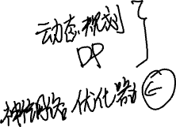
Lecture_11
李老师& 开课吧人工智能学院课程组
2020.03

Slide 2
Dynamic Programming

Slide 3
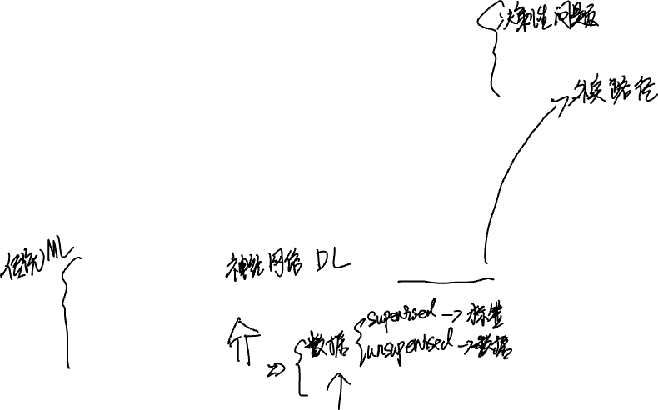
Outline
Review: Machine Learning Models
Random Forest
Bayes
Support Vector Machine
K-means
XGBoost
Solving Intelligent Problem by Dynamic Programming
Search Policy
Dynamic Programming

Slide 4

The problems machine learning hard to solve
1. Lacking plenty data.
2. Lacking plenty labeled data.
3. Related inference or decision.

Slide 5
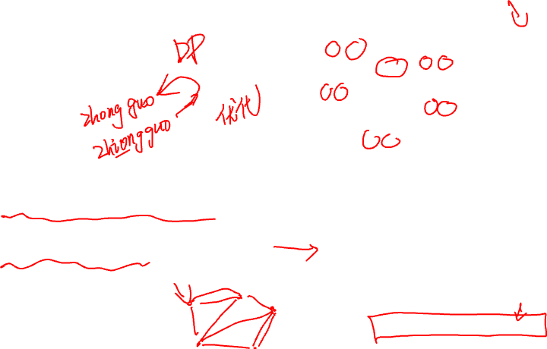
Such as
knapsack problem 背包问题
travel salesman problem 旅行商问题
Auto correction 自动纠错

Slide 6

Search Policy
We have learnt Breath First Search and Depth First Search
These could solve several problems

Slide 7

The Issue of Search
Time or(and) Space Complexity may be huge!

Slide 8
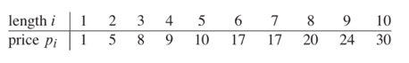
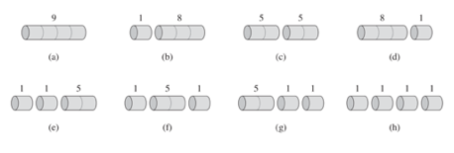
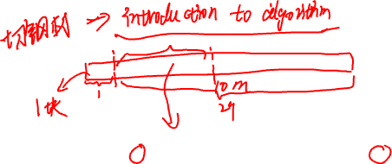
A simple example: Cutting Problem
You are a businessman
You want best revenue

Slide 9

The other similar problems
Longest Common Sequence
Travel Salesman Problem
Decision Problem
Optimal Problem

Slide 10

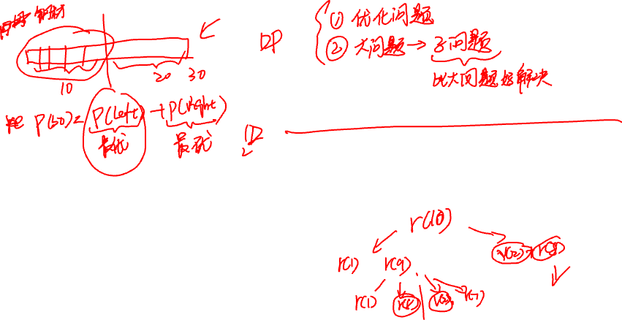
Solution of Cutting Problem
（online coding）

Slide 11
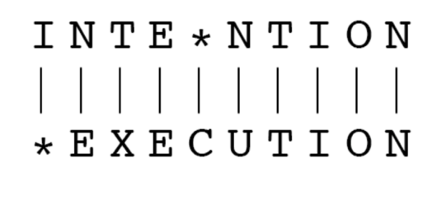
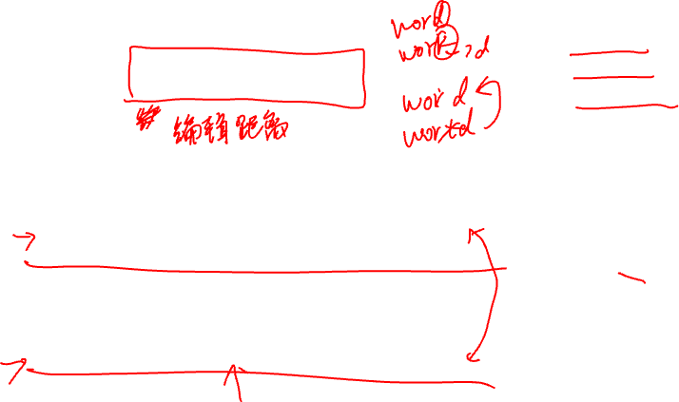
Case2: Edit Distance
• Insertion
• Deletion
• Substitution
Spell Correction
The user typed “biejing”
--biejie? (别介)
--beijing? (北京)
--beijin? (北金)
Evaluating Machine Translation and speech recognition
Spokesman confirms senior government adviser was shot.
Spokesman said the senior adviser was shot dead.

Slide 12
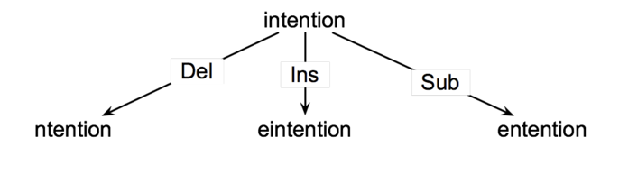
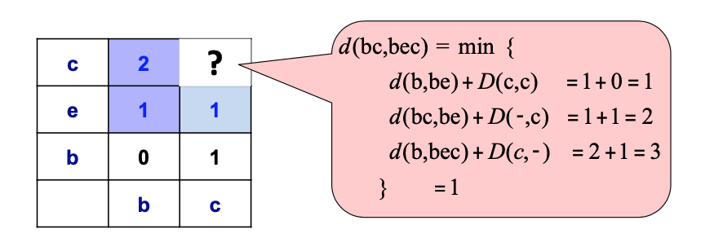
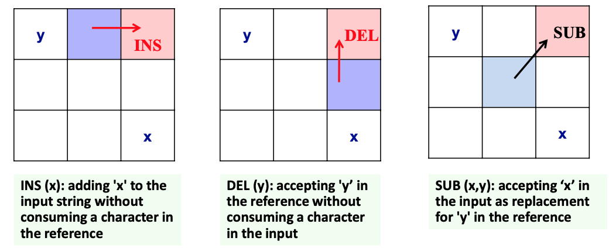
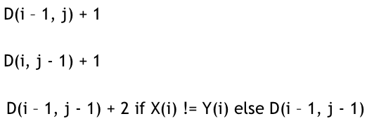
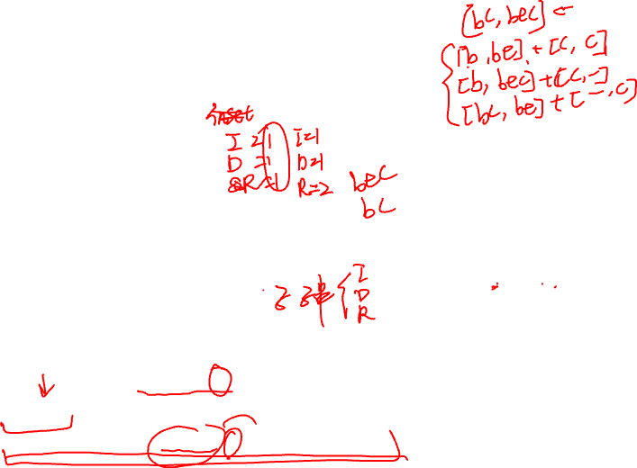
Algorithm of Edit Distance
For two strings
X of length n
Y of length m
We define D(i, j)
the edit distance between X[1…i] and Y[1..j]
The edit distance between X and Y is thus D(n, m)
Initialization
D(i, 0) = i
D(0, j) = j
D (i, j) = min

Slide 13

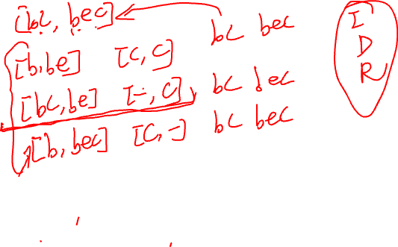
Edit Distance Algorithm Implementation
(online coding)

Slide 14

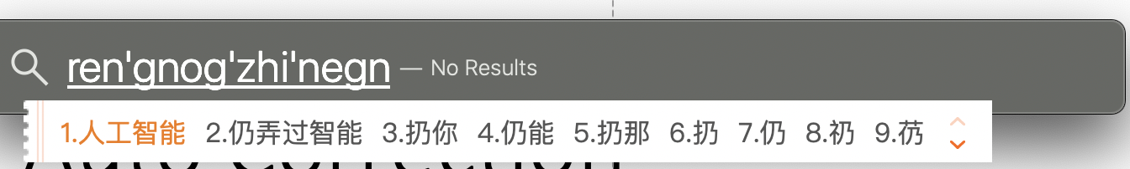

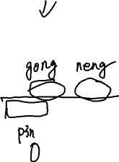
Case3: Auto Correction
汉语拼音自动纠错程序
Spelling Correction Problem
How to implement it?

Slide 15
Pinyin Auto Correction Problem
(online coding)

Slide 16
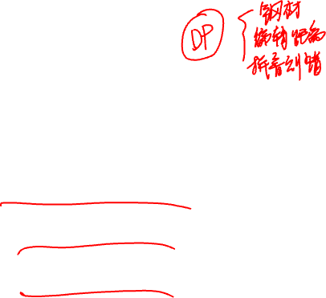
Conclusion
Three main features of dynamic programming:
Subproblem
Overlapping
Parse Solution

Slide 17

Assignment
1. Review the course programming code;
2. Complete the Edit-Distance Problem Solution, by which we could get the detailed transformer procedure of two string X and Y.
2. Complete the Pinyin auto-correction problem

Slide 18
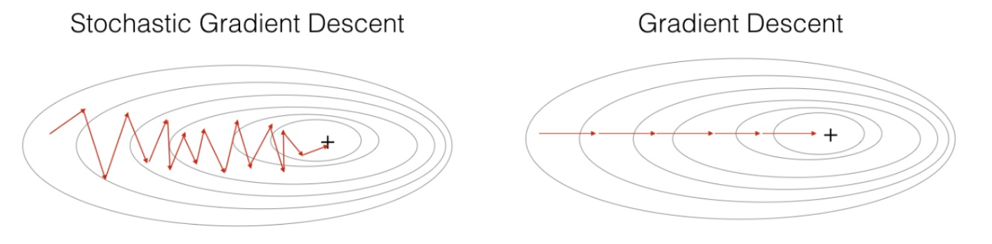
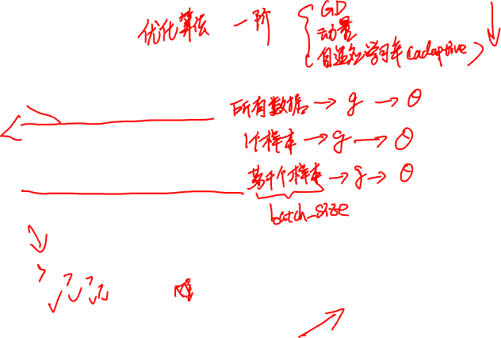
Optimizers
Batch Gradient Descent (BGD)
Stochastic Gradient Descent (SGD)
Minibatch Gradient Descent (MBGD)

Slide 19
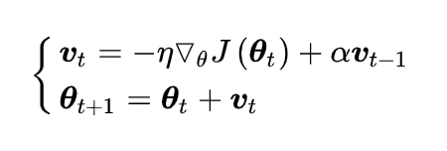
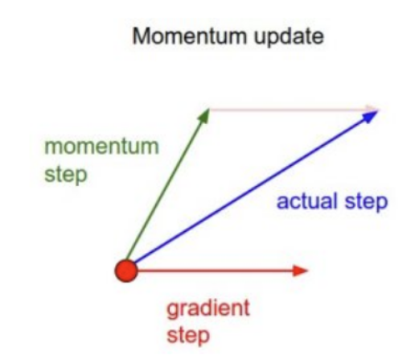
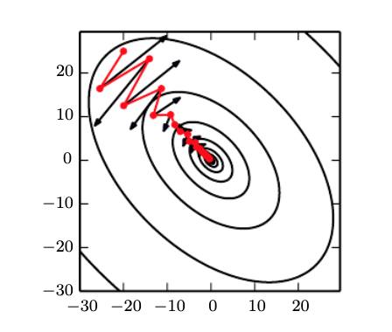

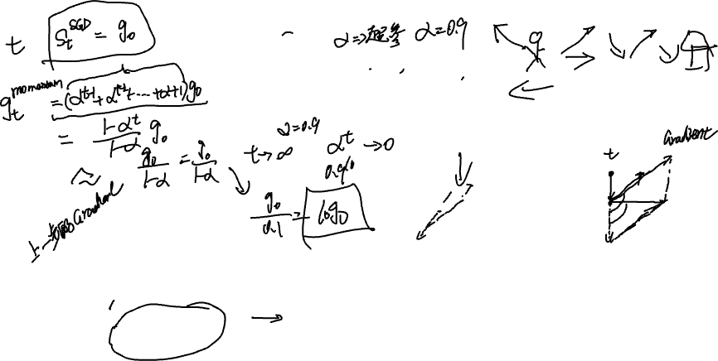
Optimizers (Momentum)

Slide 20
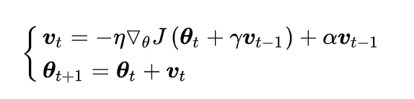
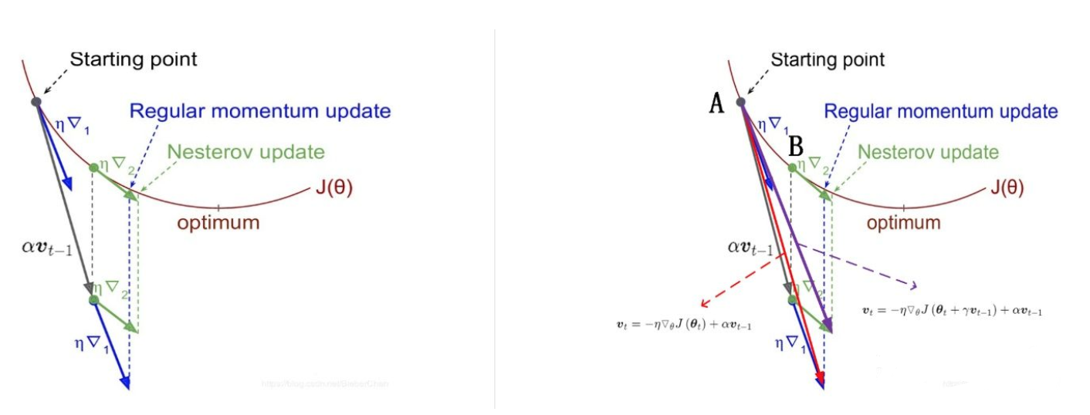
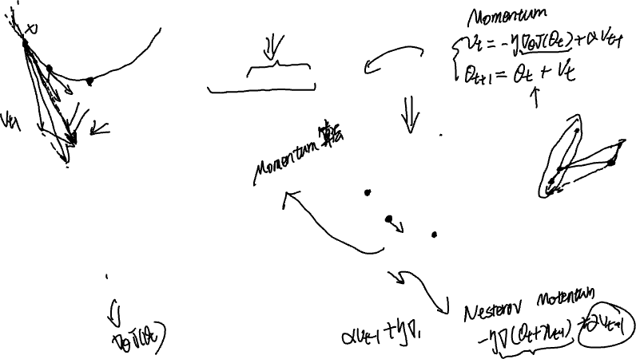
Optimizers ( Nesterov Momentum)

Slide 21
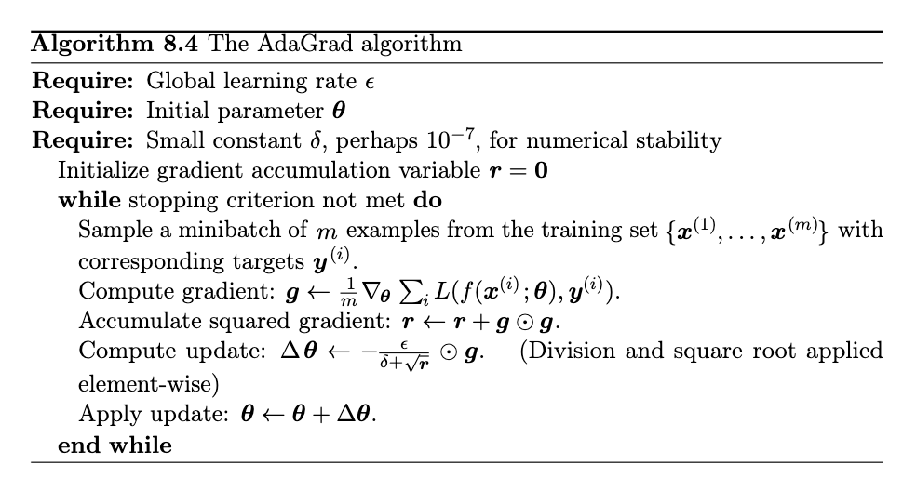
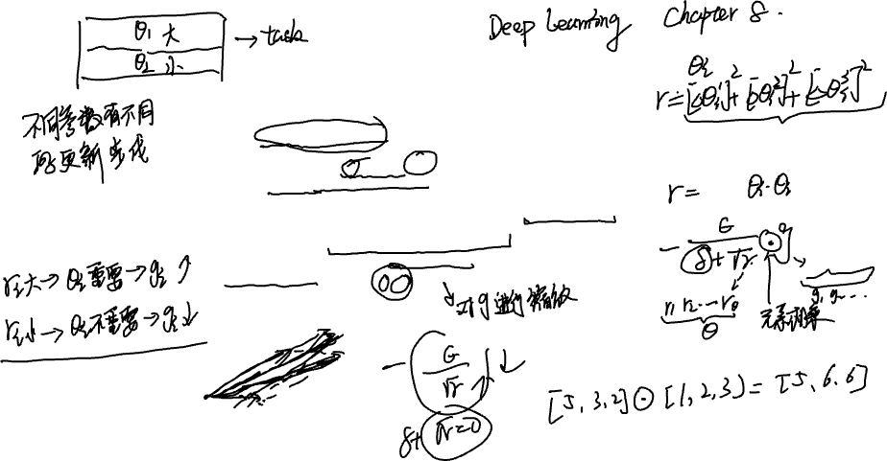
Optimizers ( Adaptive Gradient)

Slide 22
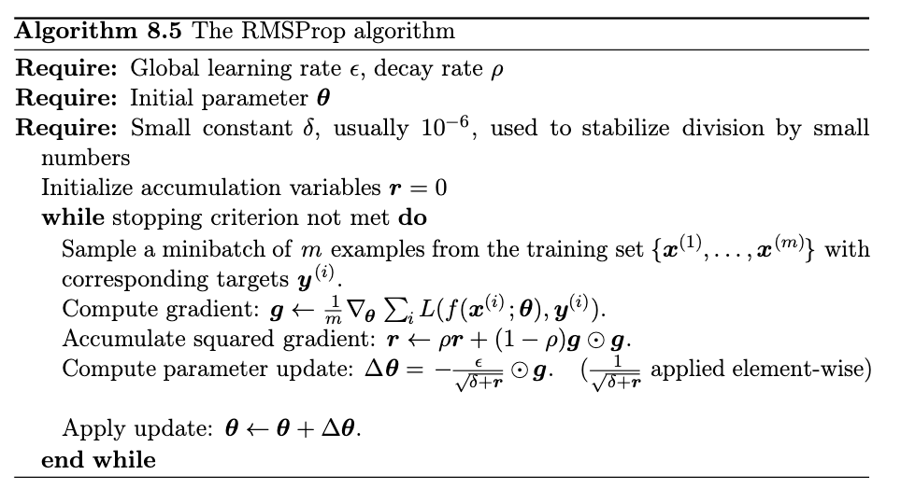
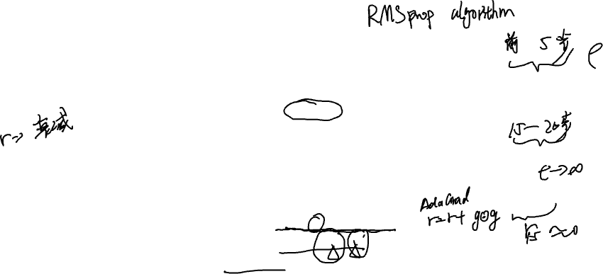
Optimizers ( Adaptive Gradient)

Slide 23
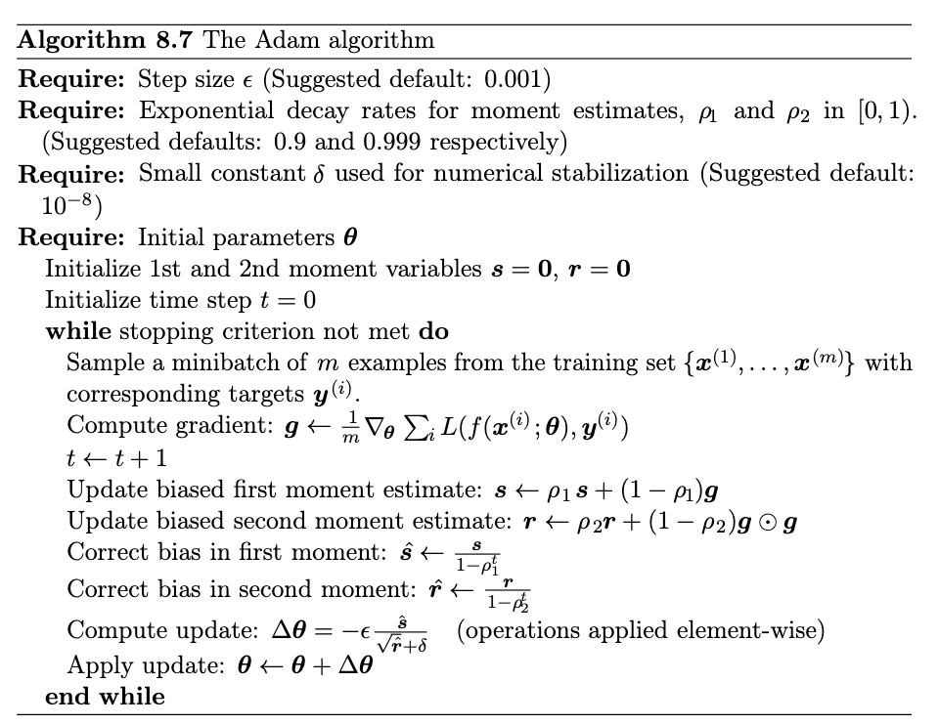
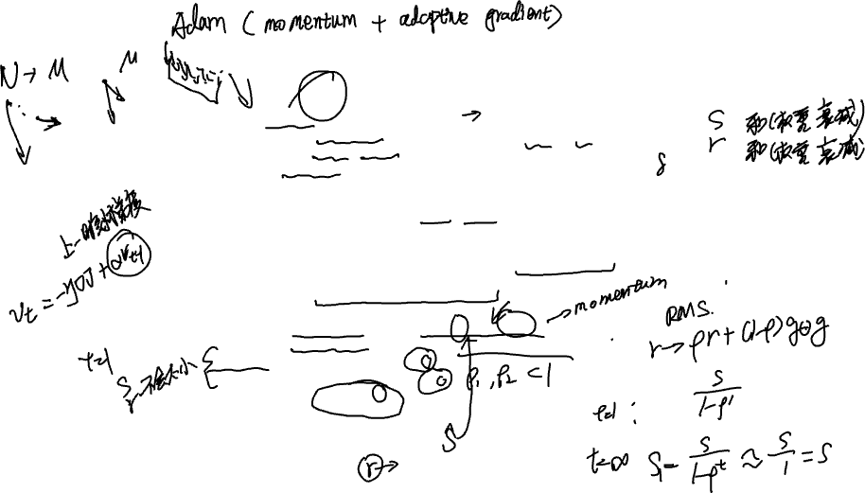
Optimizers

Slide 24
